Slide 1

Predicting the Probability of Recidivism
By: Kyle Hanson, Christine Orosco, Myra Rust

Slide 2
Presentation Outline
Background
Data Cleaning and Transformation
Preliminary Analysis
Modeling Methods
Feature Selection
Model Selection & Evaluation
Model Results
Conclusion
Future Work

Slide 3

Introduction
What is recidivism?
67.8% of convicts reoffend within 3 years.
Project Objective - Use historical data and machine learning to predict the probability an individual will reoffend.
Motivation - Provide probabilities to decision makers.
Notes:
According to a 2005 study conducted by the Bureau of Justice Statistics
Note: Our dataset recidivism rate does not align with the national average of 67.8% reoffend. In our dataset it's 33.3%.

Slide 4
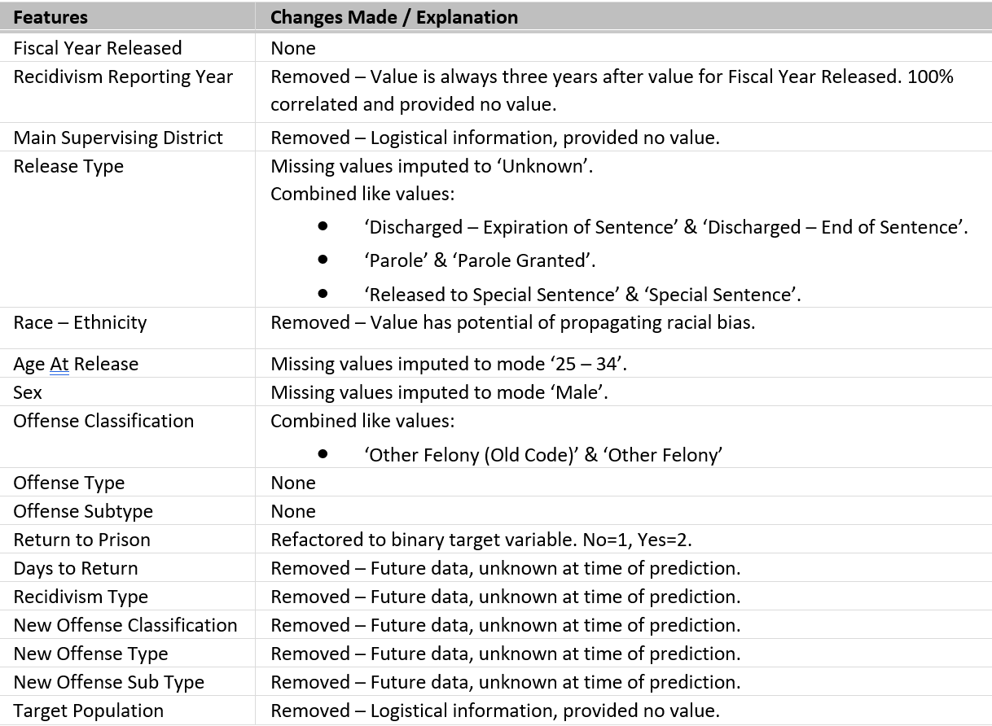
Data Cleaning & Transformation
Data Source
3-Year Recidivism for Offenders Released from Prison in Iowa (Iowa Department of Corrections, 2020).
Data range from 2010 – 2018
26020 total observations
Cleaning and Transformation
Remove variables
Impute missing values
Combine values
One-hot encoded variables for model input
Notes:
Data entry procedures changed over time and required transformation.

Slide 5
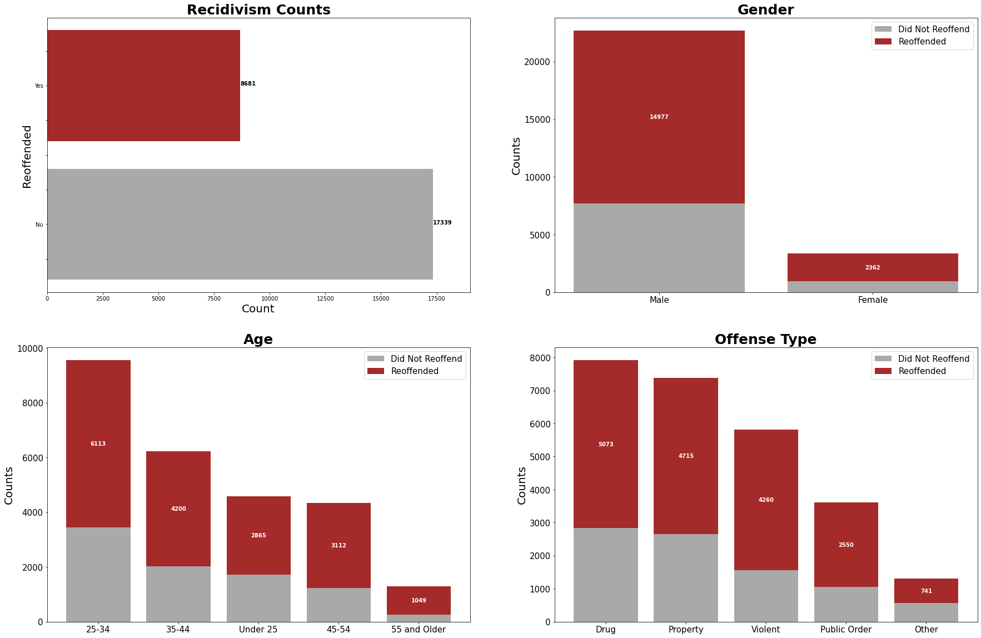
Exploratory Data Analysis
Notes:
Recidivism rate in dataset is 33.3%. This does not align with national average of 67.3%.

Slide 6
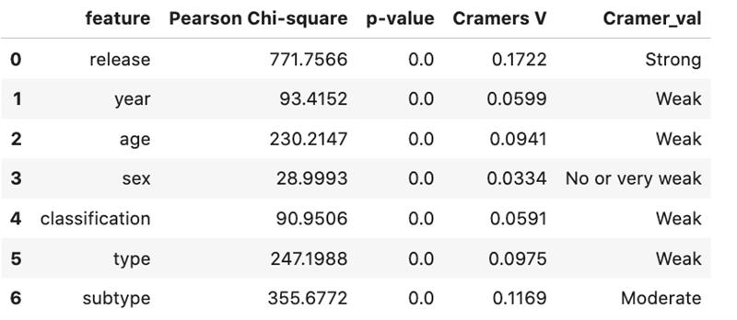
Correlation to Target Variable

Slide 7

Model Selection
Naïve Bayes – Accuracy: 0.35%
Logistic Regression – Accuracy: 0.59%
Random Forest – Accuracy: 0.61%
AdaBoost
- -
Random Forest complimented by AdaBoost was the most accurate.

Slide 8
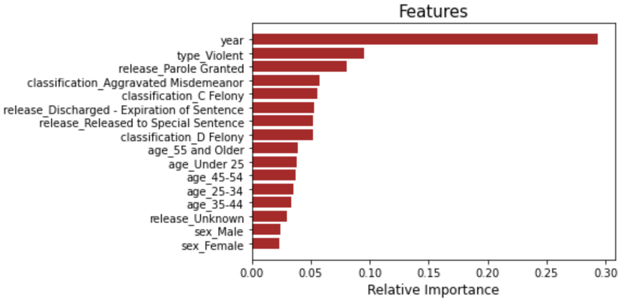
Feature Selection
• RandomForestClassifier
• SelectFromModel
• New data frame of extracted features was created

Slide 9
Model Evaluation
Split the dataset using a 70/30 train/test
Utilized default parameters to establish a baseline metric.
Hyperparameter tuning
Cross validation
Random Forest Classification:
BASELINE CLASSIFICATION MODEL - 0.497
INITIAL RANDOM FOREST MODEL - 0.580
TUNED RANDOM FOREST MODEL - 0.580
ADABOOST MODEL – Mean CV Score: 0.6614
TUNED ADABOOST MODEL – Mean CV Score: 0.6624

Slide 10
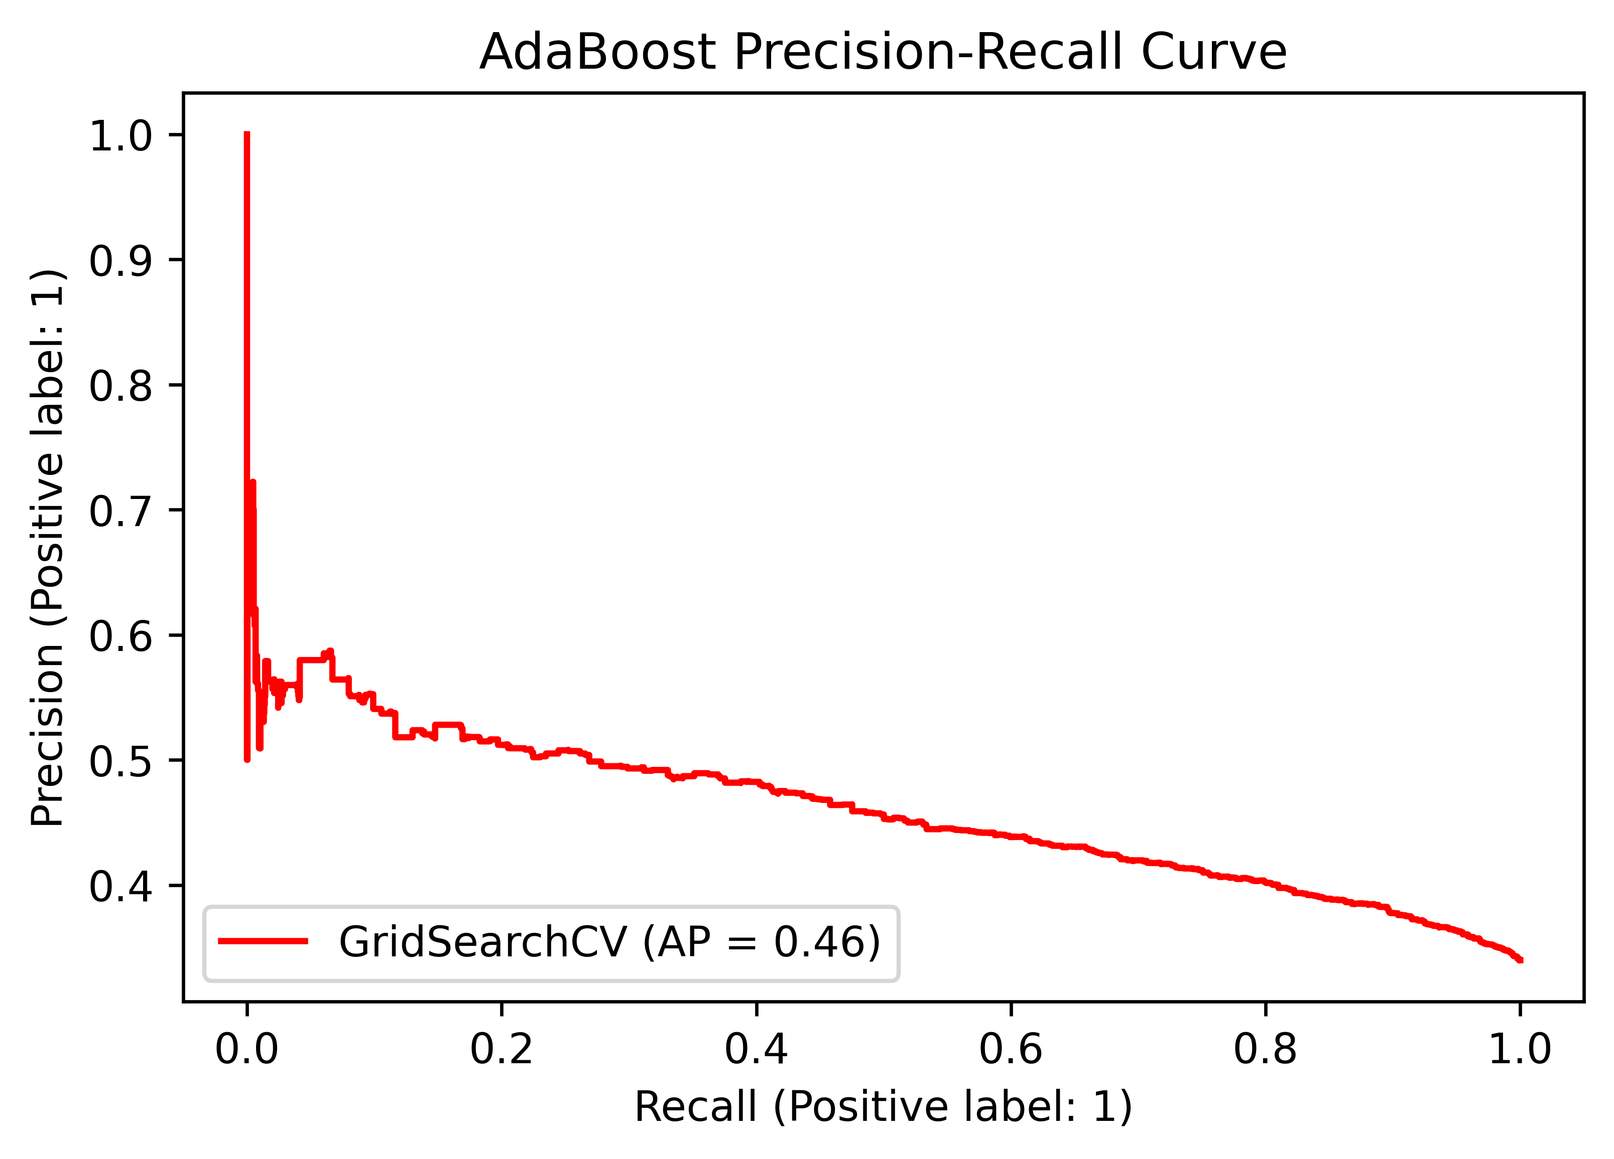
AdaBoost Results
Mean Accuracy | 0.66
AUC | .6428
Precision | Weighted Avg | 0.64
Recall | Weighted Avg | 0.60
F1 | Pos 0.51 | Neg 0.66

Slide 11
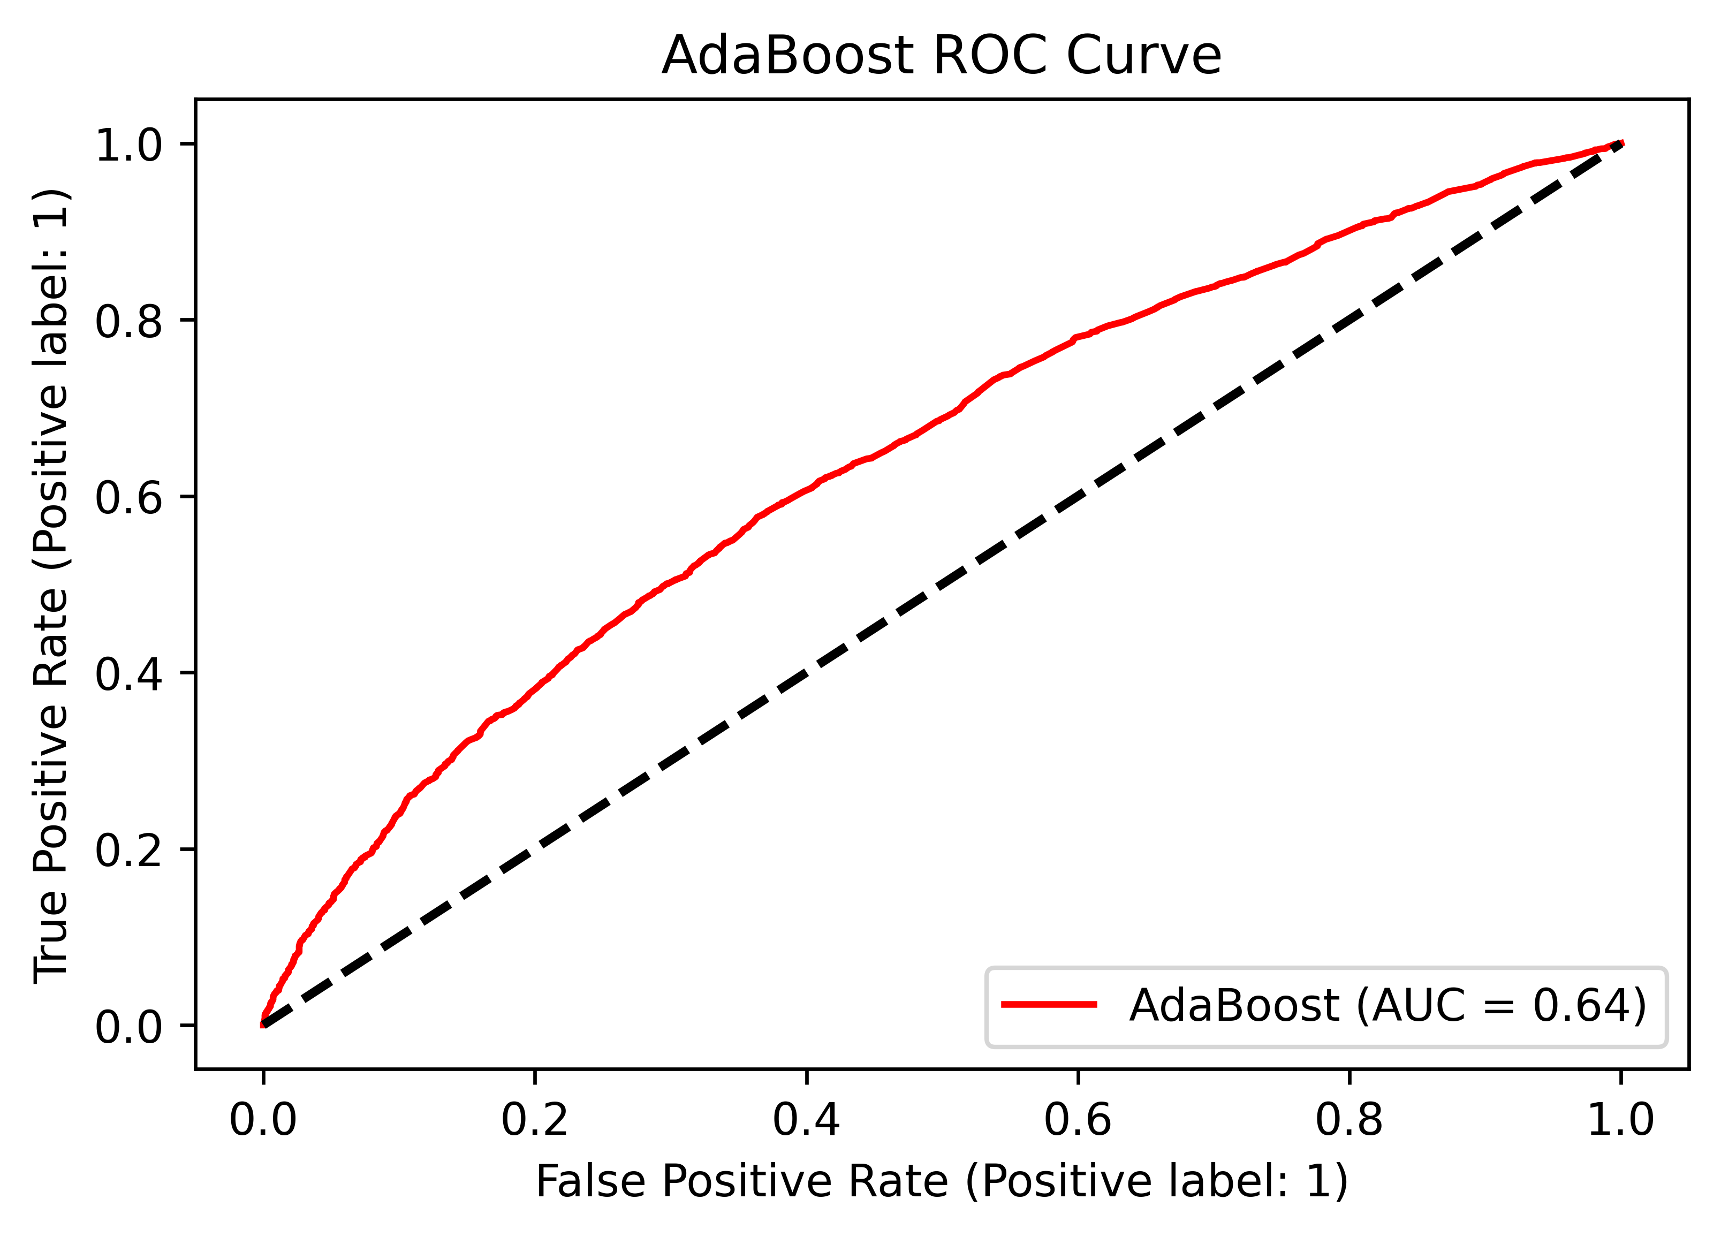
AdaBoost ROC Curve
ROC Curve indicative of poor results.
Curve close to the zero line.
AUC generalizes the accuracy.

Slide 12
Additional Models
Stacked Ensemble
Random Forest
Naïve Bayes
Logistics Regression
Accuracy
63
Weighted Average Ensemble
Random Forest
Naïve Bayes
AdaBoost
Accuracy
66
Neural Network
3 Layers
Compile with
Adam Optimizer
Loss binary cross entropy
Accuracy
66

Slide 13
Conclusions
Model not accurate enough for critical decisions
Weak or no correlation amongst variables
Not enough variables in the dataset
Need additional variables to train the model
Examples of additional variables (Florida Department of Corrections, 2020)
Social Cognitive factors
Inmate Education
Inmate Incarceration
Notes:
Recidivism rate in dataset is 33.3%. This does not align with national average of 67.3%.

Slide 14
Future Work
Acquire datasets from the Florida Department of Corrections
Explore Ensemble machine learning models
Explore Feed Forward Neural Network model
Notes:
Recidivism rate in dataset is 33.3%. This does not align with national average of 67.3%.

Slide 15
References / Citations
Durose, M., Cooper, A., Snyder, H. (2014, April 22). Recidivism of Prisoners released in 30 states in 2005: Patterns From 2005 – 2010 – Update. Bureau of Justice Statistics. Retrieved from https://www.bjs.gov/index.cfm?ty=pbdetail&iid=4986.
Iowa Department of Correction. (2020, November 16). 3-Year Recidivism for Offenders Released from Prison in Iowa. Iowa Data. Retrieved from https://data.iowa.gov/Correctional-System/3-Year-Recidivism-for-Offenders-Released-from-Pris/mw8r-vqy4.
Florida Department of Corrections. (2020, June). Florida Prison Recidivism Report: Releases from 2008 to 2018. http://www.dc.state.fl.us/pub/recidivism/2019-2020/FDC_AR2019-20.pdf

